Slide 1


Coffee Shop Sales Analysis
Project Overview:
"This project focuses on analyzing the sales performance of a coffee shop using SQL for data analysis and Power BI for visualization."
"The primary goal is to gain insights into sales trends, product popularity, and customer behavior to help drive business decisions.“
Methodology:
"Using SQL, I performed detailed data analysis on transaction records, extracting insights such as sales by product, sales trends over time, and customer purchasing patterns."
"The results were then visualized in Power BI to provide an intuitive and interactive way to understand the data and highlight key performance indicators."

Slide 2

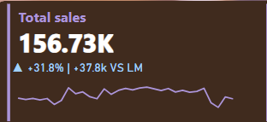
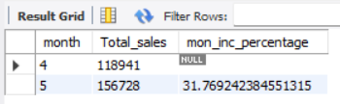
Key Performance Indicators
This dataset has contains the sales of coffee for six months i.e. from January to June (2023), while our objective is to analyze KPI’S .
Total Sales Analysis:
1.1 Calculated the total sales for each respective month.
Here I have analyzed the sales for the month of May, executed the query in SQL and visual representation is on power bi each representing KPI
Note: We can view the sales for respective month just by changing the month number in the query and selecting that month on Power bi .
1.2 Calculate the difference in sales between the selected month and the previous month and determine the month-on-month increase or decrease in sales.
The fired query depicts beautifully the percentage increase in sales from last month which is 31.76% and rounded off in dashboard which shows the accuracy of the code .
Month-on- month increase is there which shows positive sales (156728-118941= 37,787) and that we can see in the dashboard as well .
.

Slide 3

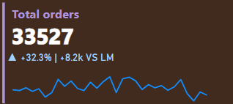
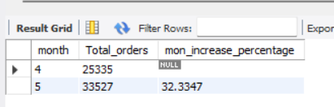
2. Total Orders Analysis:
2.1 Calculate the total number of orders for each respective month.
The result of the query will show the total orders for each respective month again I have selected May month in order to get the total orders for another month we can simply change the month number , query for the same has been mentioned in the Sql file .
2.2 Calculate the difference in the number of orders between the selected month and the previous month and Determine the month-on-month increase or decrease in the number of orders.
As per this result we can understand that total orders has been increased from previous month (33527 – 25335 = 8192 This figure has been rounded off in power bi ) and from the percentage increase in 32.3% which means that in the month of May sales was quite good.

Slide 4
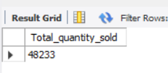
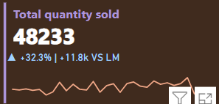
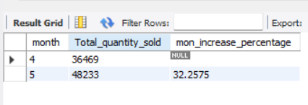
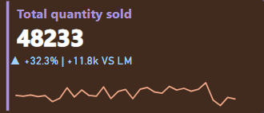
3. Total Quantity Sold Analysis:
3.1 Calculate the total quantity sold for each respective month.
Again we can see that the with the similar query and making slight changes to it we can find total quantity for the month or any other month .
3.2 Calculate the difference in the total quantity sold between the selected month and the previous month and Determine the month-on-month increase or decrease in the total quantity sold.
As we can see that the increase in quantity sold is (48233-36469 = 11,764) which will result in 32.25%

Slide 5
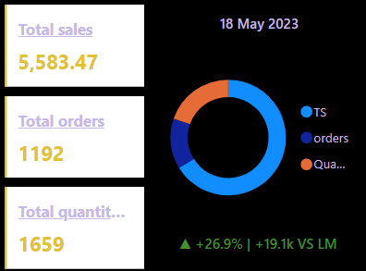
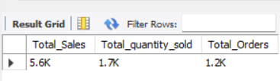
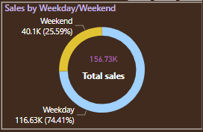
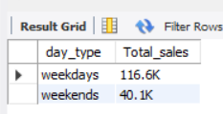
4. Calendar Heat Map:
• Implemented a calendar heat map that dynamically adjusts based on the selected month from a slicer.
• Each day on the calendar is color-coded to represent sales volume, with darker shades indicating higher sales.
• Implemented tooltips to display detailed metrics (Sales, Orders, Quantity) when hovering over a specific day.
.
5. Sales Analysis by Weekdays and Weekends:
Segmented sales data into weekdays and weekends to analyze performance variations.
Provides insights into whether sales patterns differ significantly between weekdays and weekends.
We can see sale of coffee for the month of May is more on weekdays than on weekends the reason could be the following :
Work Routines: Many customers likely buy coffee on their way to work or during breaks, making weekdays busier for coffee sales.
Less Leisure Time on Weekends: On weekends, people might prefer to relax at home or engage
in leisure activities, reducing their need for coffee purchases outside.

Slide 6
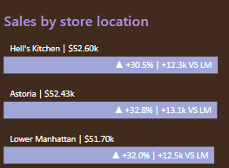
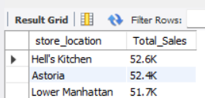
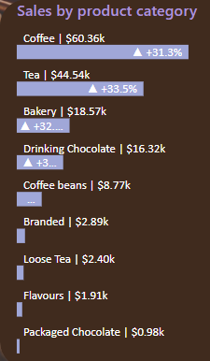
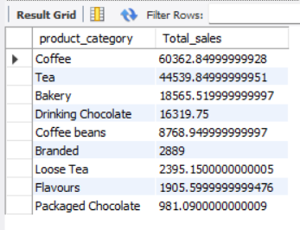
6. Sales Analysis by Store Location:
Visualized sales data by different store locations.
Includes month-over-month (MoM) difference metrics based on the selected month in the slicer.
Highlighted MoM sales increase or decrease for each store location to identify trends.
7. Sales Analysis by Product Category:
Analyzed sales performance across different product categories.
Provides insights into which product categories contribute the most to overall sales.

Slide 7
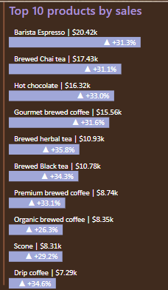
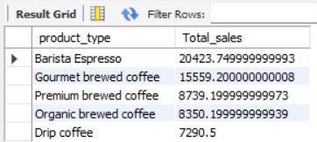
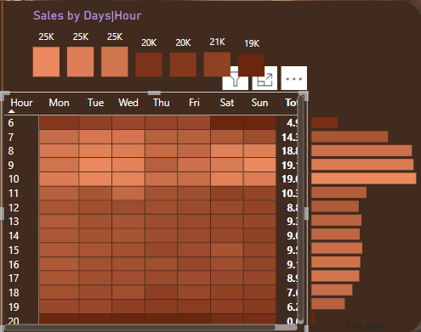

8. Top 10 Products by Sales:
List of top 10 products based on sales volume.
9. Sales Analysis by Days and Hours:
Heat map has been used to visualize sales patterns by days and hours.
Implemented tooltips to display detailed metrics (Sales, Orders, Quantity)
when hovering over a specific day-hour.
It is observed that peak hours are from 7AM to 10 Am and sales in average in
mid- afternoon hours which can be the point of concern .

Slide 8
Executive Summary
Over the past six months, the coffee shop has demonstrated strong sales performance, particularly during weekdays, driven by the morning rush and workday routines.
Key insights from the analysis revealed that certain products, such as Barista Espresso and brewed chai tea , consistently lead in sales after the month of February .
Revenue Trends
"The shop saw a steady increase in monthly revenue, with notable sales growth from the month of March starting at 98,835 and then continuously increased by the end of six months that is till June it was maximum at 1,66,485."
"Average order value increased when customers ordered their specialty coffee with any bakery product at it is maximum at 35,353 in the month of June 2023.
Challenges and Opportunities
"Sales dip during the mid-afternoon, representing a potential opportunity to introduce afternoon promotions or limited-time discounts."
"Certain product categories, like coffee beans, loose tea, packaged chocolate underperformed , suggesting a need for better seasonal adjustments.”
Actionable Recommendations
"Introduce targeted promotions for less popular products during off-peak hours to balance sales across the day.”
Example : Introduce BOGO sale Buy One Get One Free on those items which customers can prefer packing for home .
Conclusion
"Overall, the coffee shop has performed well, with steady growth in revenue and strong customer loyalty.

